Slide 1
Ortho Eyes
Raphael Pickl, Brice Lang-Nguyen,
Eddie Versluis, Hassan Ali, Arjun Sardjoe Missier, Lennart van Koppen, Rachelle Kiepe, Dr. Tony Andrioli

Slide 2

LUMC
Laboratorium for Kinematics en Neuromechanics (LK&N)
Improving treatment and diagnosis of musculoskeletal system issues
Our research is focused on shoulder issues

Slide 3
Goniometer
Not accurate at all
Measurement bias

Slide 4
History of project
First iteration (2017)
Research with kinect
Second iteration (2018)
Flock of birds – logistic regression
Third iteration (2019)
Flock of birds – unsupervised learning

Slide 5
First Iteration
2017
108 people recorded with Kinect
K-means clustering attempt was made
Not medical relevant due to the lack of diagnosed patients

Slide 6
Second Iteration
2018
Diagnosed Patient Data
Flock of Birds Sensor
Logistic Regression
Results are encouraging, but not confirmed because assumptions on data were made.

Slide 7
Third Iteration
2019
More patient data
Clarification about the data
Unsupervised learning techniques

Slide 8
Flock of Birds
Giant Electro-Magnetic field generator
Consists of multiple Hall Sensors
Reads Magnetic Field
Returns them as XYZ coordinates
of bone structures
This Data is translated to relational XYZ angles

Slide 9
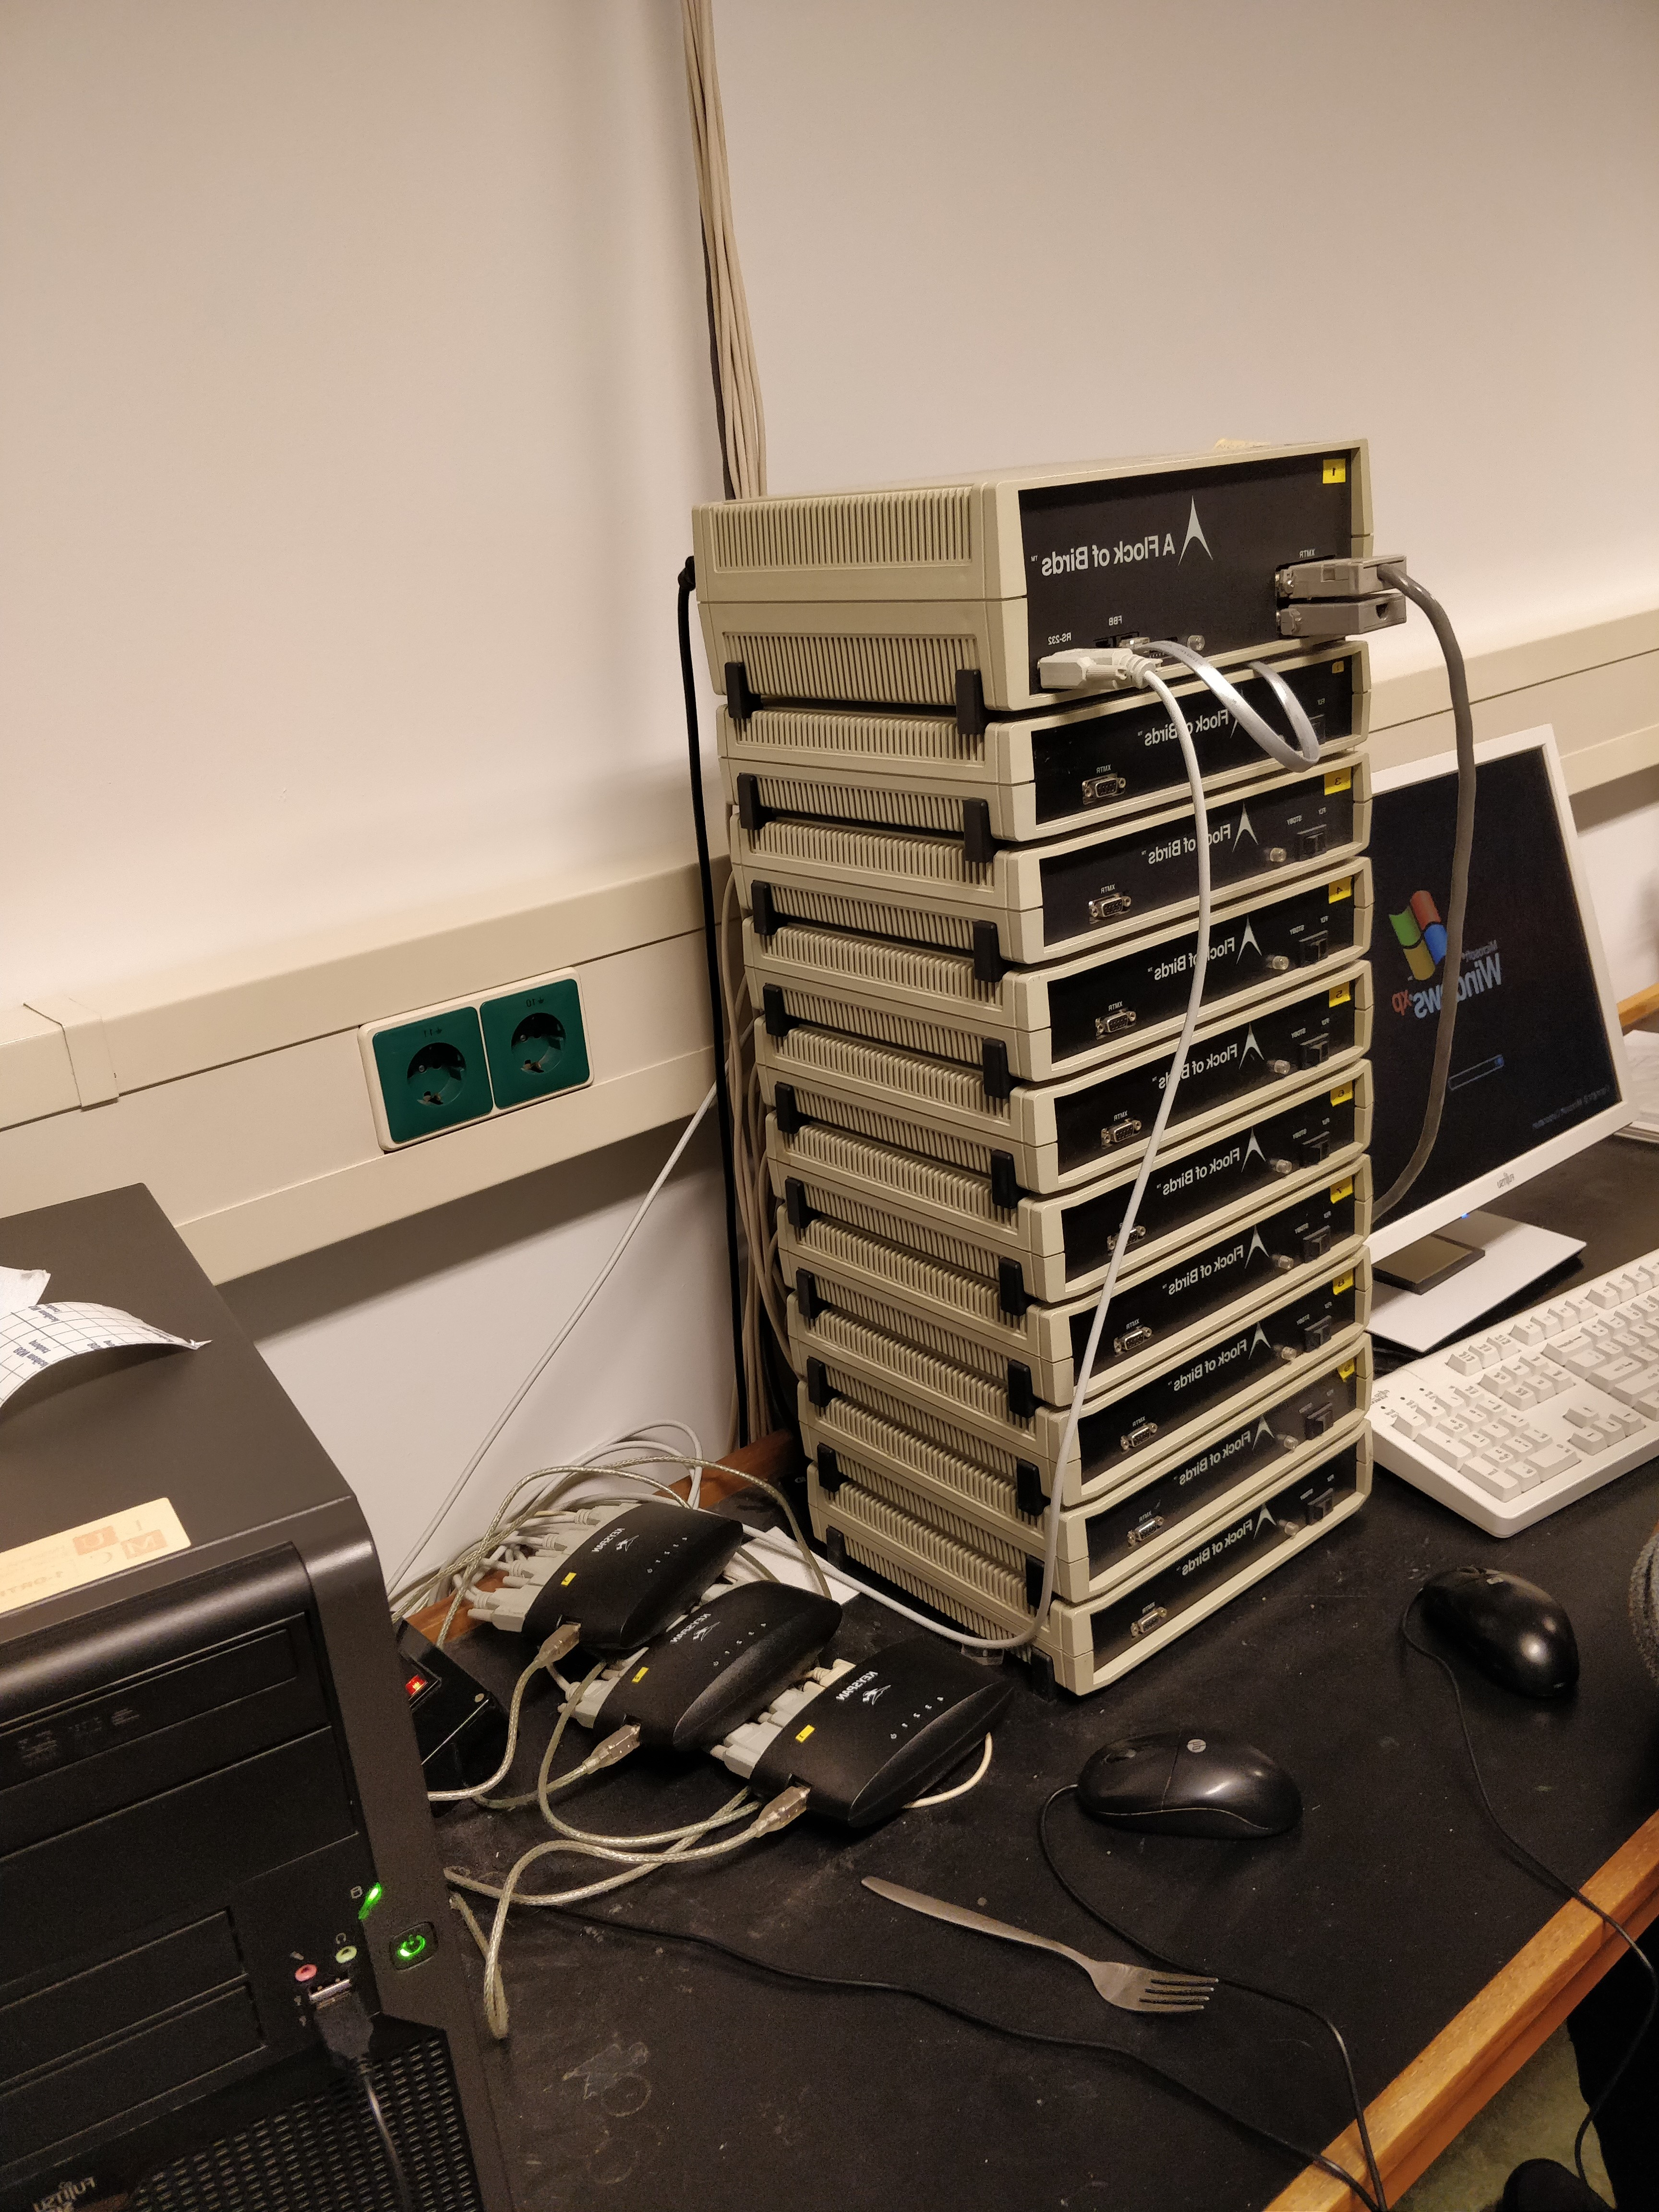
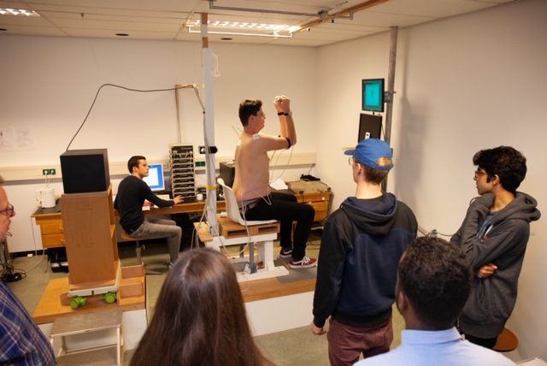
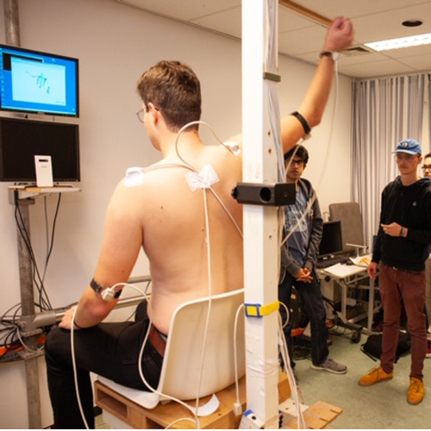

Slide 10
Step 1
Understanding the results of iteration 2 and confirming the results.
In the proces we received more data and insights on the data.
We know what data belongs to what exercises
We made our own kinematic recordings
Introduced anomalies

Slide 11
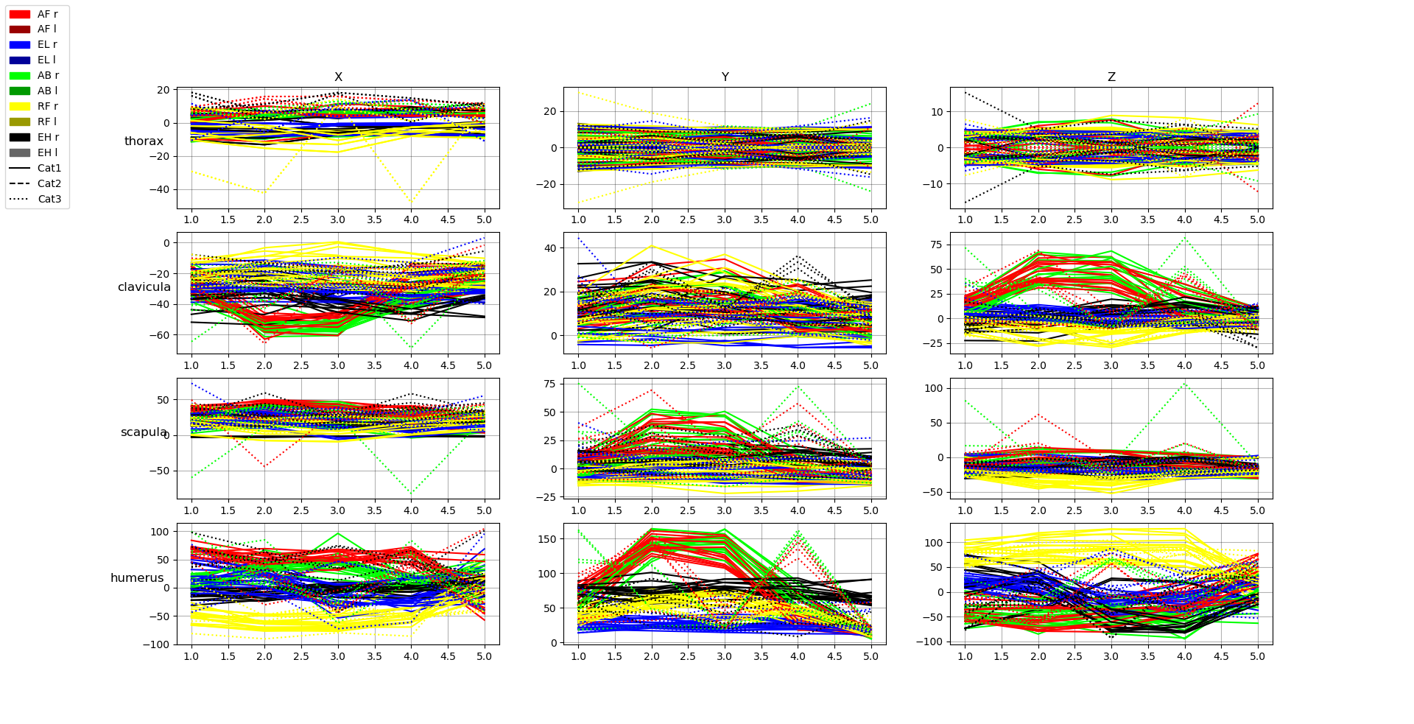
Step 2
Anomaly detection
Swapped sensor data
Incorrect file names
Double exercises in one file
Decide what excercises to use in the model
Using unsuperviced methods to find stucture in the data
K-means, t-SNE (PCA), neural network , DBSCAN

Slide 12

Questions?

